Slide 1
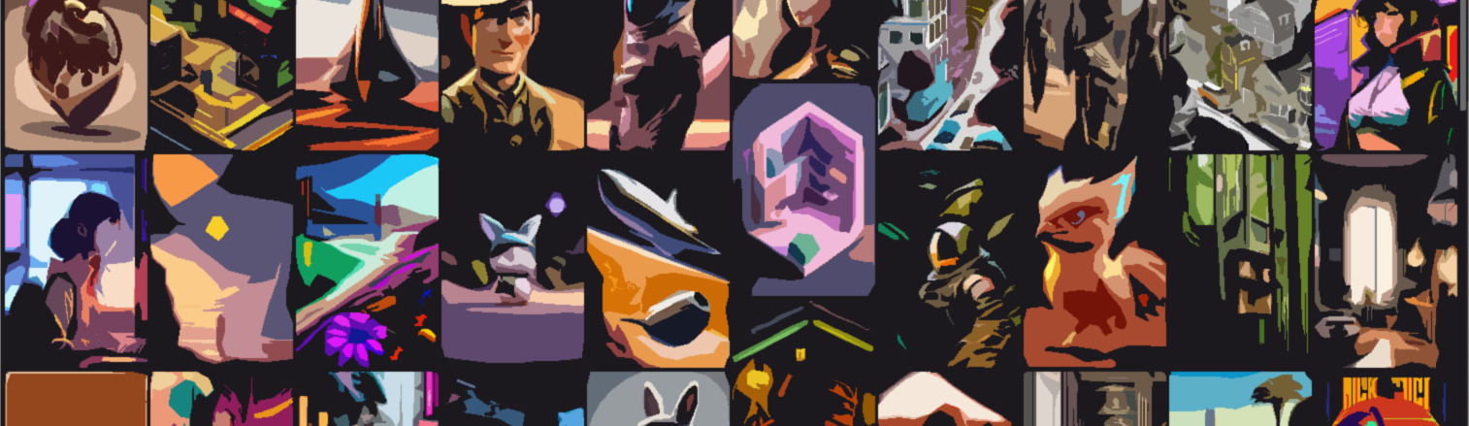
Stable Diffusion
احمد محمود حسيني
علي ماهر عبدالسلام
محمد احمد طه
محمد حسام عثمان
محمد عاطف ربيع

Slide 2
Content
Introduction
Model
Experiments & Results
Conclusion

Slide 3
Stable Diffusion
Introduction

Slide 4
Content
Introduction
Model
Experiments & Results
Conclusion

Slide 5
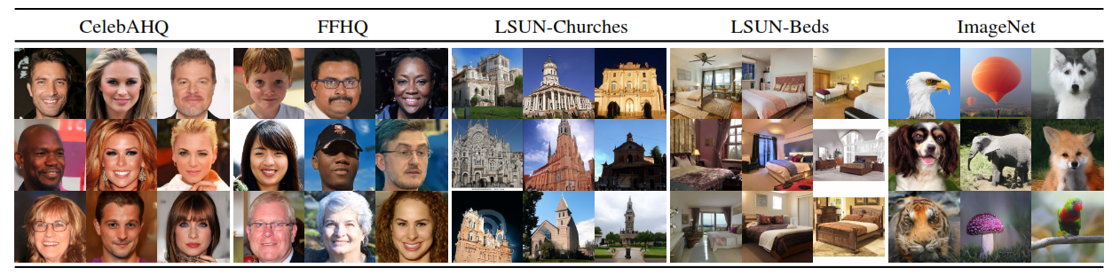
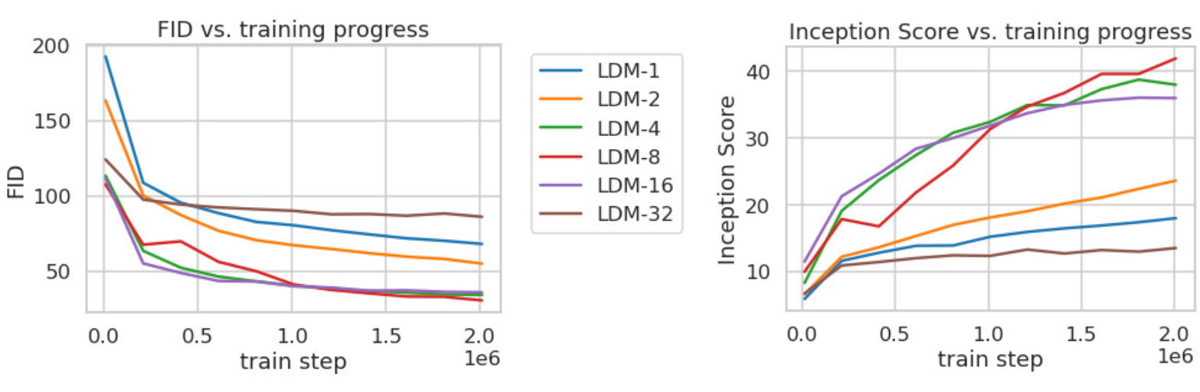
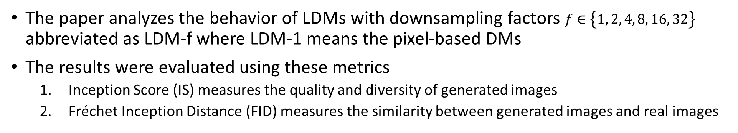
1. Compression Trade-off
Stable Diffusion
Experiments & Results
The LDM-4 and LDM-8 offer the best conditions to achieve high-quality synthesis results
The paper analyzes the behavior of LDMs with downsampling factors $f∈\left\{1, 2, 4, 8, 16, 32\right\}$ abbreviated as LDM-f where LDM-1 means the pixel-based DMs
The results were evaluated using these metrics
Inception Score (IS) measures the quality and diversity of generated images
Fréchet Inception Distance (FID) measures the similarity between generated images and real images

Slide 6
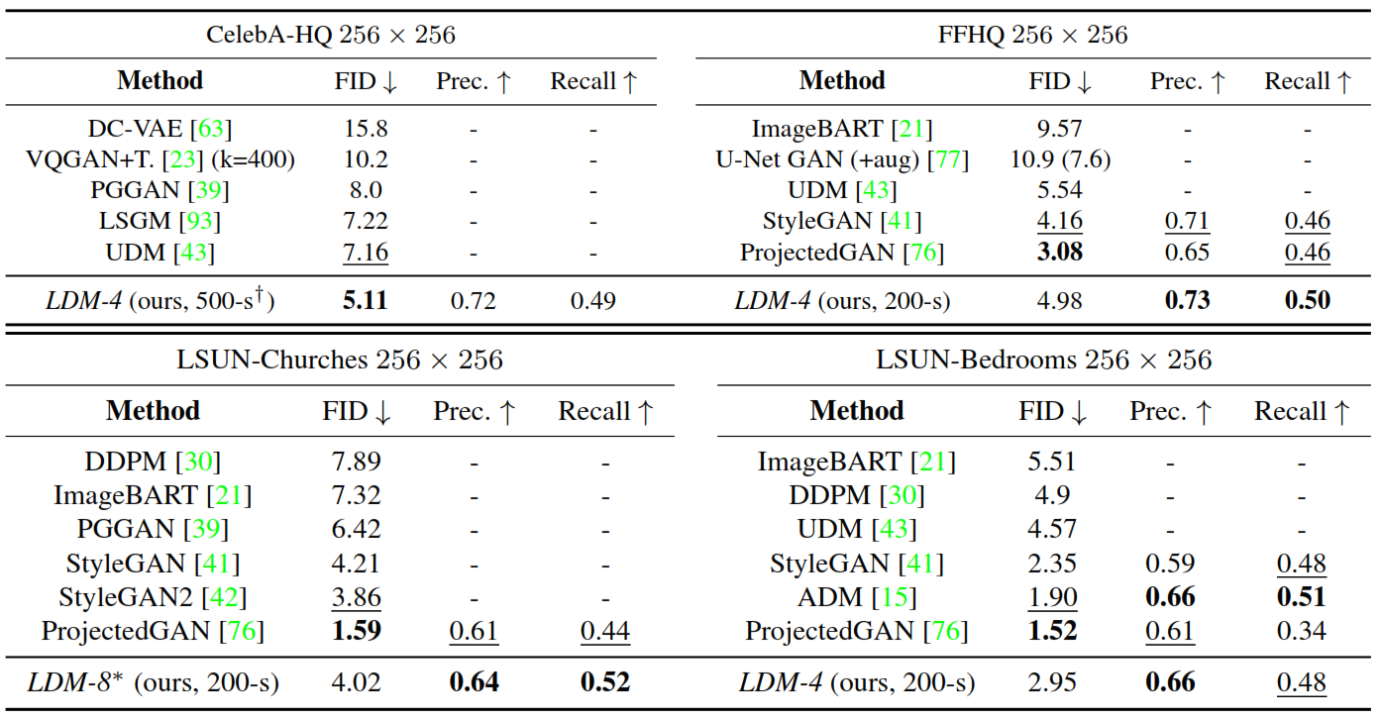
2. Image Generation with Latent Diffusion
Stable Diffusion
Experiments & Results
training of unconditional models of 256x256 images on the mentioned datasets. Then evaluate the quality using FID, Precision and Recall
A new state-of-the-art FID of 5.11
LDMs consistently improve upon GAN-based methods in Precision and Recall

Slide 7
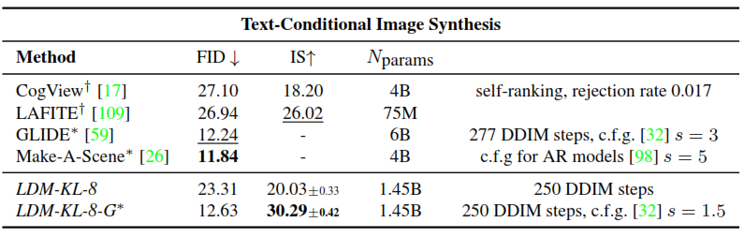
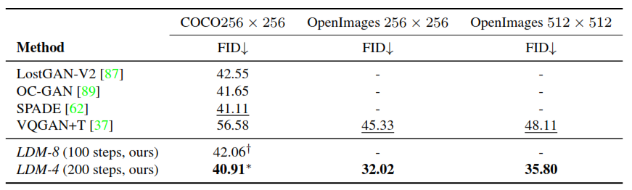
3. Conditional Latent Diffusion
Stable Diffusion
Experiments & Results
results after introducing cross-attention based conditioning into LDMs for the text-to-image synthesis
The paper follows prior work and evaluate text-to-image generation on the MS-COCO validation set

Slide 8
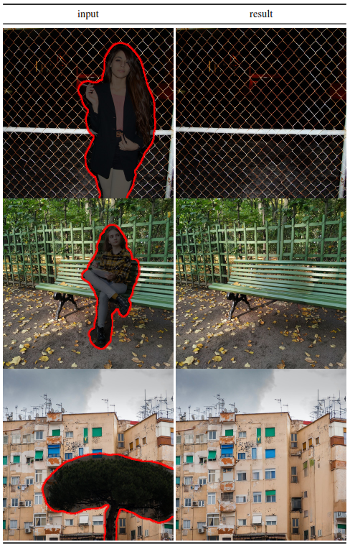
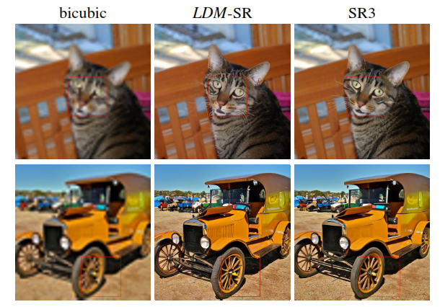
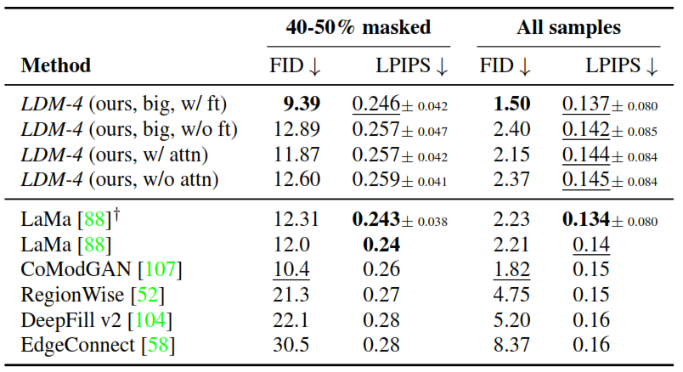
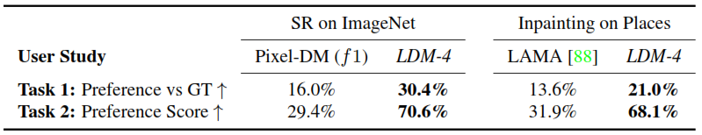
4. Super Resolution and Inpainting
Stable Diffusion
Experiments & Results
Compare super resolution with SR3
Compare Inpainting with LaMa

Slide 9
Content
Introduction
Model
Experiments & Results
Conclusion

Slide 10



Conclusion
Stable Diffusion
Conclusion
we presented a new trend that took over the internet over the past year which is text to image generation using stable diffusion
Many references influenced our understanding of the paper and stable diffusion concept
The Illustrated Stable Diffusion, Jay Alammar
Stable Diffusion Code first release code
Stable Diffusion Slides in Details

Slide 11


